Slide 1
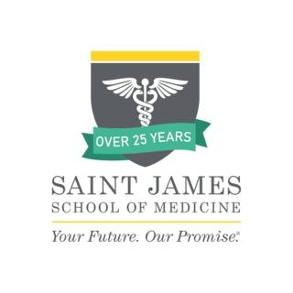

EFFECTIVENESS OF NEUROTECHNOLOGY TREATMENT ON PARKINSON’S DISEASE IN FEMALES AND MALES A SYSTEMATIC REVIEW
Investigators: Samir, Sammy, Taonga, Matthew, Fidelis, Roya, Mentor: Dr. Alexey Pryakhin
Introduction
Parkinson's disease (PD) is a progressive neurodegenerative disorder defined by the atrophy of dopaminergic neurons in the substantia nigra, which causes motor and non-motor symptoms such as trepidation, rigidity, bradykinesia, and postural instability. Pharmacotherapy for PD include drugs such as levodopa, dopamine agonists, and monoamine oxidase-B inhibitors providing symptom alleviation and increasing everyday functioning. Deep brain stimulation (DBS), a surgical procedure that includes implanting electrodes in specific brain regions, has emerged as a highly effective treatment option for individuals with advanced Parkinson's disease who do not respond well to medication.
Literature Review
Deep Brain Stimulation (DBS) is a surgical treatment that includes implanting electrodes in specific brain regions for persons with advanced Parkinson's disease (PD) who are not responding well to medication (Zhang, T. et al, 2024). Levodopa and other dopamine agonists are examples of pharmacotherapy, which is still the mainstay of Parkinson's disease treatment since they reduce symptoms and enhance day-to-day functioning as Senek et al. (2017) demonstrate.
Proprioceptive neuromuscular facilitation (PNF) and robotic-assisted gait training (RAGT) are two examples of specialized therapies that increase functional independence and reduce the risk of falls, according to Lee et al. (2024).
Discussion
DBS was applied to STN and GPi with improvements seen in terms of reduction in medication dosage and psychiatric symptoms, respectively. Another study simply established that the application of DBS to PD patients show marked improvements in motor function and activities of daily living. PNF improved motor functioning, psychiatric symptoms and activities of daily living but it does not reduce medication dosages.
RAGT improved motor function improved the activities of daily living and psychiatric symptoms without any effect on the medication dosages.
Conclusion
Deep Brain Stimulation (DBS) remains the most effective treatment for improving the quality of life in Parkinson's disease patients, particularly in terms of motor and non-motor symptom management.
Methods
Utilizing PubMed, British Journal of Medicine database, Google scholar, and American Journal of Medicine a search review was conducted to find and review articles relating to DBS, PNF and RAGT. The most recent articles were filtered and Boolean operators (AND, OR, NOT) were used to identify the most relevant articles using keywords in the search that included “Deep Brain Stimulation, Modern Treatments, DBS, PNF, and Parkinson’s Disease, Robotic-assisted Gait Training (RAGT), proprioceptive neuromuscular facilitation (PNF)”.
References
Shah, H., Usman, O., Ur Rehman, H., Jhaveri, S., Avanthika, C., Hussain, K., Islam, H., & I S K, S. (2022). Deep Brain Stimulation in the Treatment of Parkinson's Disease. Cureus, 14(9), e28760. https://doi.org/10.7759/cureus.28760

