Slide 1

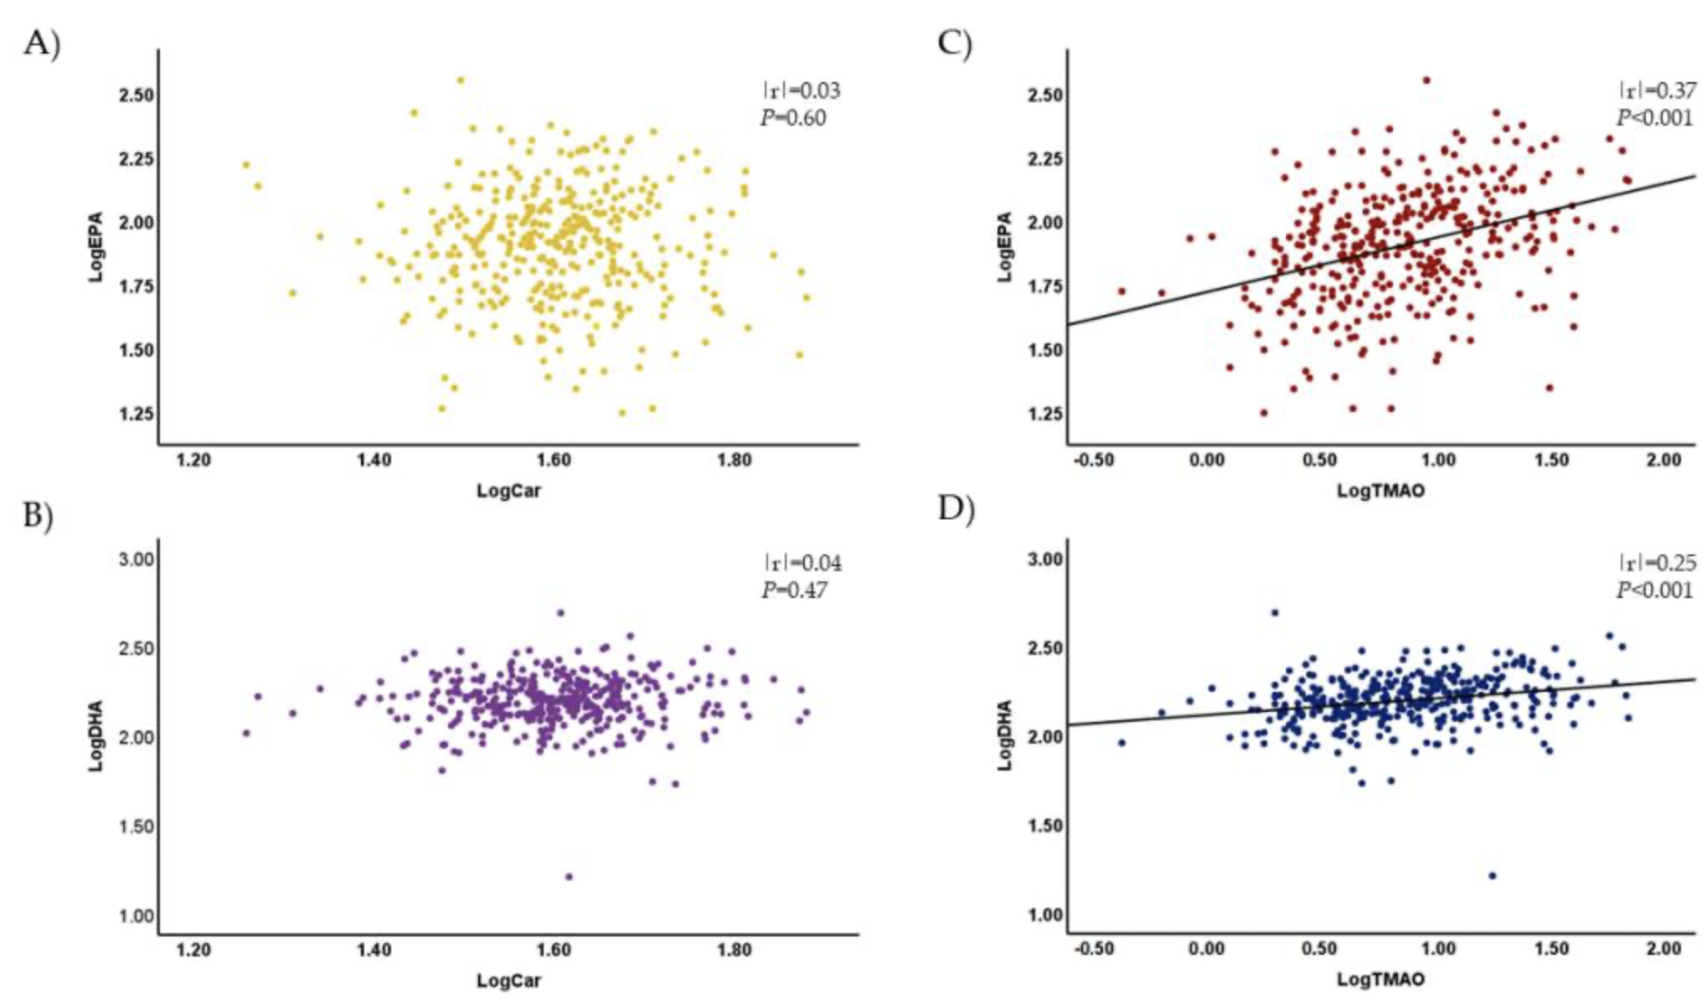
THE ROLE OF TRIMETHYLAMINE N-OXIDE IN RED MEAT WITH RESPECT TO CARDIOVASCULAR HEALTH RISKS AND HUMAN SYSTEMIC CIRCULATION
Meena Sahely,Vanessa klein, Daniel Todd, Shania Okorie, Melchor L Bareng, PhD, PGCOHS, PGCCTM
Introduction
TMAO, a meat preservative, may increase long-term cardiovascular health risks.
Hypothesis: Higher TMAO levels correlate with greater cardiovascular risk.
Seven studies reviewed TMAO's links to:
- Heart failure
- Type 2 diabetes
- Atherosclerosis (association vs. non-association)
- Potential therapeutic use
- TMAO in dietary supplements
- Effects of lifestyle changes on obesity
- Post-myocardial infarction risk stratification
- Studies assessed for relevance, methodology, and statistical integrity.
- Provides a comprehensive view of TMAO’s role in cardiovascular health.
Results
- TMAO as a CVD Biomarker: Elevated TMAO has been consistently linked to worsened cardiovascular outcomes,
especially in atherosclerosis and post-myocardial infarction cases.
- Heart Failure Indicator: High TMAO levels correlated with poor outcomes in heart failure
patients.
- Therapeutic Potential: Pharmacological agents (e.g., BMB, I3C) and lifestyle changes (caloric
reduction, exercise) lowered TMAO and improved cardiovascular health.
- Inconsistent Supplement Findings: Results for TMAO-lowering supplements varied, indicating a
need for standard methodologies in future studies.
- Mechanistic Gaps: More research is needed on how TMAO drives inflammation and plaque formation.
- Population-Specific Effects: Mixed findings across populations; older Japanese adults showed no
TMAO-atherosclerosis link, suggesting genetic/lifestyle influence.
- Future Research Needs:
Longitudinal studies on lifestyle changes and sustained TMAO effects.
TMAO’s role in conditions beyond CVD, like type 2 diabetes, where it showed biomarker potential.
Plasma L-carnitine showed no correlation with EPA or DHA, while plasma TMAO significantly correlated with both. TMAO and L-carnitine were measured using LC-MS/MS, and EPA and DHA via GC-MS. Pearson’s correlation of log-transformed data revealed distinct relationships for these biomarkers (Bhuiya et al., 2023).
Methodology
Narrative and Systematic Reviews Approach:
Reviewed existing literature and experimental trials, examining biochemical pathways and therapeutic interventions (e.g., dimethyl-1-butanol, indole-3- carbinol) for reducing TMAO production.
Clinical Case-Control and Cohort Studies Approach:
Compared TMAO plasma levels in patient groups with specific conditions (e.g., heart failure, type 2 diabetes) against control groups, assessing correlations with risk factors (e.g., insulin resistance, lipid profiles).
Population-Based Cross-Sectional Analysis Approach:
Collected data on carotid artery thickness, blood pressure, and plasma TMAO levels, comparing these markers with cardiovascular risk indicators, stratified by demographic factors.
Intervention and Lifestyle Modification Studies Approach:
Implemented diet and exercise interventions, measuring TMAO plasma levels, VO2 max, and fasting glucose pre- and post-intervention to evaluate changes and their impact on cardiovascular health.
Longitudinal Cohort Studies on Prognostic Value of TMAO Approach: Monitored TMAO levels and clinical outcomes (e.g., mortality, hospitalization) over time in heart failure patients, analyzing trends in correlation to cardiac health.
Conclusion
TMAO as a Biomarker:
Supports TMAO’s role as a significant biomarker for cardiovascular risk and other conditions, including type 2 diabetes and obesity.
Risk Reduction Strategies:
TMAO reduction through compounds, lifestyle changes, or dietary interventions have the potential to mitigate cardiovascular risks, especially in high-risk groups.
Research Gaps:
More standardized interventions, population-specific studies, and mechanistic insights are needed to optimize TMAO-targeted strategies.
Public Health Implications:
Routine TMAO screening could enable earlier interventions and preventive strategies, promoting lifestyle changes to reduce cardiovascular risk in at-risk populations.
References
Bhuiya, J., Notsu, Y., Kobayashi, H., Shibly, A. Z., Sheikh, A. M., Okazaki, R., Yamaguchi, K., Nagai, A., Nabika, T., Abe, T., Yamasaki, M., Isomura, M., & Yano, S. (2023). Neither Trimethylamine-N-Oxide nor Trimethyllysine Is Associated with Atherosclerosis: A Cross-Sectional Study in Older Japanese Adults. Nutrients, 15(3), 759. https://doi.org/10.3390/nu15030759
Erickson, M. L., Malin, S. K., Wang, Z., Brown, J. M., Hazen, S. L., & Kirwan, J. P. (2019). Effects of Lifestyle Intervention on Plasma Trimethylamine N-Oxide in Obese Adults. Nutrients, 11(1), 179. https://doi.org/10.3390/nu11010179
Kalagi, N. A., Abbott, K. A., Alburikan, K. A., Alkofide, H. A., Stojanovski, E., & Garg, M. L. (2019). Modulation of circulating trimethylamine N-oxide concentrations by dietary supplements and pharmacological agents: A systematic review. Advances in Nutrition, 10(5), 876–887. https://doi.org/10.1093/advances/nmz012
Oktaviono, Y. H., Lamara, A. D., Saputra, P. B., Arnindita, J. N., Pasahari, D., Saputra, M. E., & Suasti, N. M. (2023). Roles of trimethylamine-N-oxide in atherosclerosis and its potential therapeutic aspect: A literature review. Biomolecules and Biomedicine, 23(6). https://doi.org/10.17305/bb.2023.8893
Suzuki, T., Heaney, L. M., Jones, D. J. L., & Ng, L. L. (2017). Trimethylamine N-oxide and risk stratification after acute myocardial infarction. Clinical Chemistry, 63(1), 420–428. https://doi.org/10.1373/clinchem.2016.264853
Tang, W. H., Wang, Z., Fan, Y., Levison, B., Hazen, J. E., Donahue, L. M., Wu, Y., & Hazen, S. L. (2014). Prognostic value of elevated levels of intestinal microbe-generated metabolite trimethylamine-N-oxide in patients with heart failure: refining the gut hypothesis. Journal of the American College of Cardiology, 64(18), 1908–1914. https://doi.org/10.1016/j.jacc.2014.02.617
Zhou, J., Liu, S., & Song, X. (2022). Dietary Patterns and Breast Cancer Risk: A Meta-Analysis. Nutrients, 14(10), 2093. https://doi.org/10.3390/nu14102093

